Slide 1
Intro to Azure
NorCal PowerShell & Azure UserGroup
Presented By:
$TOM = @{
Name = “Tom Peffers”;
Job = “Solutions Architect @ Sada Systems”;
Verbose = $true;
}

Slide 2
Agenda
Azure Experience, Training, and fun on the cheap!
Azure Platform Overview
Quick tour
Rest API interface
Compute overview
Azure and PowerShell
How to Locate the modules
How to connect into Azure
How to create a VM with PowerShell
How to deploy a template with PowerShell
Leveraging Azure for Automation
Azure Automation
DSC
PowerShell Runbooks
Azure Functions
Azure Logic Apps

Slide 3


$Tom.Aboutme
Solutions Architect in the Enterprise Solutions group @ SADA Systems
Current Relevant Certifications:
MCSD – Azure Solutions Architect
MCSE – Cloud Platform and Infrastructure 2017
Areas of interest:
Azure
PowerShell
DevOps
Motorcycles
Puppies
Reading

Slide 4
Azure on the Cheap! – Part 1
Microsoft Dev Essentials
Pros:
Azure Free Account plus $200 in credits for Free for 30 First 30 Days
30 Days of Training for free with the following sites:
Pluralsight
Skill me Up / Opsgility
Cons:
Typically have to sign up on your Azure account with a credit card so you can’t keep rolling new accounts to get free credits.
More Info:
https://visualstudio.microsoft.com/dev-essentials/
https://azure.microsoft.com/en-us/free/free-account-faq/

Slide 5
Azure on the Cheap! – Part 2
Action Pack (Microsoft Partner Network)
Pros:
Get tons of licenses for just about everything. (Server, Visual Studio, and Office 365)
Get $100 a month in Azure credits without the same restrictions as MSDN.
Can use credits for select Azure Market place items
$500 a year
Cons:
Have to create a business/file LLC paperwork. May result in additional fees/paper work.
Have to register as a Microsoft Partner
Have to create a website.
More Info:
https://partner.microsoft.com/en-us/membership/core-benefits#tab-content-2
https://partner.microsoft.com/en-us/membership/internal-use-software#tab-content-1

Slide 6
Azure on the Cheap! – Honorable mentions
Visual Studio Subscription (MSDN)
Pros:
Get Visual studio and azure credits for length of subscription
Cons:
Can be pricy depending on option. Maybe convince work?
More Info:
https://visualstudio.microsoft.com/vs/pricing/
DreamSpark or Student Starter?
Pros:
Get free credits and software
Cons:
Need a student email address
More Info:
https://azure.microsoft.com/en-us/pricing/member-offers/student-starter/

Slide 7
Azure Learning – On the Cheap!
Microsoft Docs ‘Azure Learning’
What is it all about?
Learning paths
Hands on learning
Pros:
Free
More Info: https://docs.microsoft.com/en-us/learn/azure/
Udemy
What is it all about?
Peer to peer learning site that has great sales from time to time.
Pros:
Can be cheaper than subscription to typical learning sites and has great material. Best when on sale!

Slide 8
Azure Learning – Aimless approach
GitHub
r/Azure (Reddit.com)
Blogs
Good place to start is Azure MVP blogs
Channel9
Microsoft Docs
Ignite
User Groups ;)

Slide 9
Azure Learning – Laser Focused
Azure Certs
https://www.microsoft.com/en-us/learning/azure-exams.aspx
Learning tracks
Either Azure Learning from Microsoft or tracks from various training sites

Slide 10
Azure Platform Overview

Slide 11
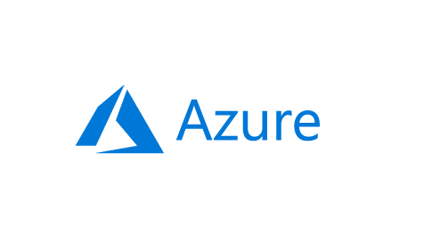

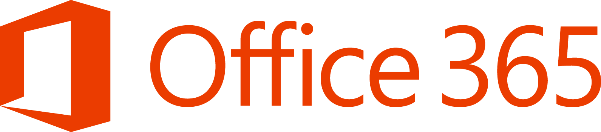





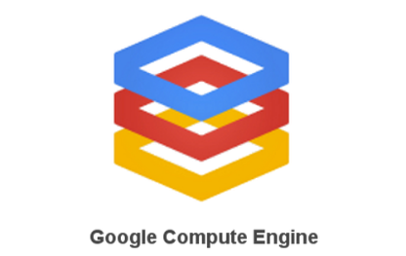
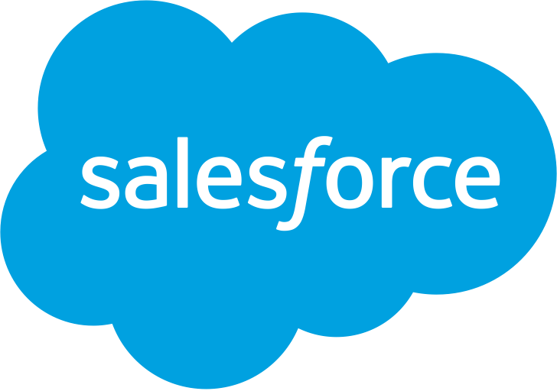
IaaS Overview
Traditional
on-premises
Infrastructure
(as a Service)
Platform
(as a Service)
Software
(as a Service)
Applications
Applications
Applications
Applications
You manage
Data
Data
Data
Data
Runtime
You manage
Runtime
Runtime
Runtime
Middleware
Middleware
Middleware
Middleware
You manage
O/S
O/S
O/S
Managed by vendor
O/S
Virtualization
Virtualization
Managed by vendor
Virtualization
Virtualization
Servers
Servers
Servers
Servers
Managed by vendor
Storage
Storage
Storage
Storage
Networking
Networking
Networking
Networking
You manage
Managed by vendor
Notes:
As you can see, the cloud journey includes many service scenarios:
On the left, you have a traditional, on-premises infrastructure which you manage completely on your own.
On the right, you have Software-as-a-Service, which includes all of the web-based tools and applications you use to run your business—think of Office 365 or Dynamics 365—running completely in the cloud, and managed fully by the vendor that provides the software.
In the middle, we have infrastructure and platform services. Building out your cloud infrastructure is your first step in moving to the cloud.
Infrastructure as a service (IaaS) is an instant computing infrastructure, provisioned and managed over the Internet. It enables you to quickly scale up and down with demand, and pay only for what you use.
IaaS helps you avoid the expense and complexity of buying and managing your own physical servers and other datacenter infrastructure.
Each resource is offered as a separate service component, and you only need to rent a particular one for as long as you need it.
The cloud computing service provider manages the infrastructure, while you purchase, install, configure, and manage your own software—operating systems, middleware, and applications.

Slide 12
Secure, cost-effective and powerful
Compute
Networking
Storage
Security and Management
Notes:
Built within an ecosystem of more than 300,000 partners, Azure offers hundreds of services to enable your cloud needs, including compute, storage, networking, and security & management.
But, unlike our competitors, we don’t just set you up with a cloud infrastructure and call the project complete … we have an innovative network of partners and experts that offer ongoing cloud training, services, and support to help you get up-to-speed, optimize your infrastructure, and continue to make smart choices about where, when, how, or if to evolve your infrastructure.

Slide 13
Compute
Azure compute provides online processing time and hosting environments for running applications in the cloud via virtual machines.
Virtual Machines
Virtual Machine Scale Sets
Availability Sets
Disks
Notes:
Azure IaaS is designed for high-end workloads and will automatically scale up or down to 1000 instances
Azure has all the power & flexibility of a Virtual Machine:
Minimal learning curve for existing virtualization pros
Run most Windows or Linux-based workloads
Easiest target for migrating to the cloud
Flexible instance sizes—use the best fit for your workload
Advanced networking and storage capabilities
Per second billing with pay-as-you-go billing (or RI)
For existing virtualization pros, the learning curve is minimal as Azure runs on most Windows or Linux-based workloads
Virtual Machines offer advanced networking & storage capabilities
Virtual Machine Scale Sets:
All of the power and flexibility of a Virtual Machine
Designed for high-end workloads
Automatically scale up (or down) to 1000 instances
Availability Sets:
Disks: Persistent, secured disk storage for Azure Virtual Machines
Simple scaling on demand lets you create thousands of disks simultaneously in minutes
Industry-leading durability and availability simultaneously replicates your data to three different replicas.
Offers you more security with granular access control
Lets you easily migrate in minutes
Multiple storage options available

Slide 14

Compute options for all types of apps
Entry level
Burstable
General Purpose
Compute Intensive
Storage Optimized
A
Av2
B
D
Dv2
Dv3
F
Fv2
L
High Performance Computing
Memory Optimized
Graphics Intensive
Purpose-built SAP HANA
G
Ev3
M
NC
NCv2
NV
ND
H
HANA
NCv3
NVv2
NDv2
(coming soon)
(coming soon)
Notes:
Key Messages: This slide simply sets the stage. Azure compute offers a rich development environment and IaaS capabilities that can help you develop a broad range of applications. For each type of application you can select the right VM that best suits your needs. We continue to expand and enrich the variety of VMs available to you so you can continue to fuel your innovation and growth to Azure.
Products recently introduced include:
1. M-Series VMs now certified for SAP HANA. You can now develop applications on Azure for the SAP HANA platform that has been recently certified for M-Series. The M-series family of Azure virtual machines are the largest memory-optimized VMs to date. These VMs are ideal for heavy in-memory workloads such as SAP HANA. With the M-Series, these databases can load large datasets into memory and utilize the fast memory access with huge amounts of vCPU parallel processing to speed up queries and enable real-time analytics. You can deploy these large workloads in minutes and on-demand, scaling elastically as your usage demands. Refer to the blog for the announcement https://azure.microsoft.com/en-us/blog/azure-m-series-vms-are-now-sap-hana-certified/
2. NVIDIA’s latest GPU for HPC and AI is available in Azure. For those of you focused on HPC applications and AI, not too long ago we announced major expansion of our GPU fleet. NVIDIA GPUs are at the heart of a lot of discovery and innovation. And with our tools like Batch, Batch AI, and the Data Science Virtual Machine images, Azure customers and developers are in a great position to expand what is possible and bring to market innovative AI and HPC applications.https://azure.microsoft.com/en-us/blog/ncv3-vms-generally-available-other-gpus-expanding-regions/ NCv3 brings NVIDIA’s latest GPU – the Tesla V100 – to our best-in-class HPC, machine learning, and AI products to bring huge amounts of value across a variety of industries. One preview customer told us their speech recognition models trained in less than 20 minutes, instead of the 1-2 hours that previous generation GPUs required. Another customer told us about the 40-50% performance boost they saw on their reservoir simulations. The ND-series, powered by NVIDIA Tesla P40 GPUs based on the new Pascal Architecture, will be excellent for training and inference. These instances will provide more than twice the performance over the previous generation for AI workloads utilizing CNTK, TensorFlow, Caffe, and other frameworks. The ND-series also offer a much larger GPU memory size (24 gigabytes), enabling you to fit much larger neural net models. Also, like our NC-series, the ND-series will offer RDMA and InfiniBand connectivity, so you will be able to run large-scale training jobs spanning hundreds of GPUs.
3. We have also announced two new VM sizes, E64i_v3 and E64is_v3, which are isolated to hardware and dedicated to a single customer. These VMs are best suited for workloads that require a high degree of isolation from other customers for compliance and regulatory requirements. You can also choose to further subdivide the resources by using Azure’s support for nested VMs. The E64i_v3 and E64is_v3 will have the exact same performance and price as their cousins E64_v3 and E64s_v3 and will be available in each of the regions where E64_v3 and E64s_v3 are available today. The small letter ‘i’ in the VM name denotes that they are “Isolated” sizes. Unlike the E64_v3 and E64s_v3, the two new E64i_v3 and E64is_v3 sizes are hardware bound sizes. They will live and operate on our Intel® Xeon® Processor E5-2673 v4 2.3GHz hardware only and will be available until at least December 2021. We will provide reminders 12 months in advance of the official decommissioning of the sizes and offer an updated isolated size like these sizes on our next hardware version. These two new E64i_v3 and E64is_v3 sizes will be available in the on-demand portal. Starting on May 1st, 2018, they will also be made available for purchase as 1-year Reserved VM Instances.
The E64i_v3 and E64is_v3 are joining our other Isolated VM sizes in the Azure family:
Standard_D15_v2
Standard_DS15_v2
Standard_E64i_v3
Standard_E64is_v3
Standard_F72s
Standard_G5
Standard_GS5
Standard_L32s
Standard_M128ms
Standard_M128s
We encourage you to use these VMs for workloads needing a high degree of isolation.
----------------------------------------
BACKGROUND INFO
Entry Level
A-series VMs have CPU performance and memory configurations best suited for entry-level workloads like development and test. They are economical and provide a low-cost option to get started with Azure.
Example use cases include development and test servers, low-traffic web servers, small-to-medium databases, servers for proof-of-concepts, and code repositories.
Burstable
B-series are economical virtual machines that provide a low-cost option for workloads that typically run at a low-to-moderate baseline CPU utilization, but sometimes need to burst to significantly higher CPU utilization when the demand rises.
Example use cases include development and test servers, low-traffic web servers, small databases, micro services, servers for proof-of-concepts, and build servers.
General Purpose
The Dv3 and Ev3 sizes are able to run Windows 2016 hosts and enable Nested Virtualization and Hyper-V Containers for these new VM sizes. Nested virtualization allows you to run a Hyper-V server on an Azure virtual machine. With nested virtualization, you can run a Hyper-V Container in a virtualized container host, set up a Hyper-V lab in a virtualized environment, or to test multi-machine scenarios. You can find more information on Nested Virtualization on Azure.
Our new Dv3 VM sizes are a good balance of memory to vCPU performance, with up to 64 vCPUs and 256 GiB of RAM. Our newly named Ev3 sizes provide you with more memory to vCPU than the Dv3, so you can run larger workloads on sizes up to our largest E64 size, with 64 vCPUs and 432 GiB of RAM. D2v3 instances are the latest hyper-threaded generation of general purpose instances.
Compute Intensive
The F-series VM sizes sport a higher CPU-to-memory ratio. They feature 2 GB RAM and 16 GB of local Solid State Drive (SSD) per CPU core, and are optimized for compute-intensive workloads. The F-series is based on the 2.4 GHz Intel Xeon E5-2673 v3 (Haswell) processor, which can achieve clock speeds as high as 3.1 GHz with the Intel Turbo Boost Technology 2.0. Example use cases include scenarios like batch processing, web servers, analytics, and gaming.
Azure now offers the fastest Intel Xeon Scalable processor, code-named Skylake, in the public cloud. In Azure, we have seen growing demand for massive large-scale computation by customers doing financial modeling, scientific analysis, genomics, geothermal visualization, and deep learning. Our drive to continuously innovate in Azure allows us to offer cost-effective and best-in-class hardware for these world-changing workloads.
Memory Optimized
The M-series family of Azure virtual machines are the largest memory optimized VMs to date. These VMs are ideal for heavy in-memory workloads, such as SAP HANA. With the M-series, these databases can load large datasets into memory and utilize the fast memory access with huge amounts of vCPU parallel processing to speed up queries and enable real-time analytics. You can deploy these large workloads in minutes and on-demand, scaling elastically as your usage demands.
G-series VMs feature the latest Intel Xeon processor E5 v3 family, two times more memory, and four times more Solid State Drive storage (SSDs) than the General Purpose D-series. G-series sport RAM of up to ½ TB and 32 CPU cores, and provide unparalleled computational performance, memory, and local SSD storage for your most demanding applications. Example use cases include large SQL and NoSQL databases, ERP, SAP, and data warehousing solutions.
Optimized for in-memory hyper-threaded applications, the E-series family of Azure virtual machines are optimized for heavy in-memory applications such as SAP HANA. These VMs are set up with high memory-to-core ratios that make them well-suited for relational database servers, with medium-to-large caches, and in-memory analytics. The E-series VMs range from 2 to 64 vCPUs and 16 to 432 GiB RAM, respectively.
Two new VM sizes, E64i_v3 and E64is_v3, which are isolated to hardware and dedicated to a single customer. These VMs are best suited for workloads that require a high degree of isolation from other customers for compliance and regulatory requirements. The E64i_v3 and E64is_v3 will have the exact same performance and price as their cousins E64_v3 and E64s_v3, and they will be available in each of the regions where E64_v3 and E64s_v3 are available today. The small letter “I” in the VM name denotes that they are “Isolated” sizes.
Graphics Intensive
NCv3 is available in East and South Central regions in the US. NCv3 brings NVIDIA’s latest GPU – the Tesla V100 – to our best-in-class HPC, machine learning, and AI products to bring huge amounts of value across a variety of industries. One preview customer told us their speech recognition models trained in less than 20 minutes, instead of the 1-2 hours that previous generation GPUs required. Another customer told us about the 40-50% performance boost they saw on their reservoir simulations.
The ND-series, powered by NVIDIA Tesla P40 GPUs based on the new Pascal Architecture, will be excellent for training and inference. These instances will provide more than twice the performance over the previous generation for FP32 (single-precision floating-point operations), for AI workloads utilizing CNTK, TensorFlow, Caffe, and other frameworks. The ND-series also offer a much larger GPU memory size (24 gigabytes), enabling you to fit much larger neural net models. Also, like our NC-series, the ND-series will offer RDMA and InfiniBand connectivity, so you will be able to run large-scale training jobs spanning hundreds of GPUs. They are available in East and West US and Southeast Asia.
HPC
H-series VM sizes are suitable for any compute-intensive workload like complex engineering and scientific workloads like computational fluid dynamics, crash simulations, seismic exploration, and weather forecasting simulations. H-series VMs come with the fastest CPUs in public cloud, as well as RDMA with InfiniBand, which allows you to run high-performance computing (HPC) apps. The H-series is available across multiple regions in the US, Europe, and Asia.
Azure offers a comprehensive set of compute options for all types of apps, including entry-level, general purpose, memory optimized, storage optimized, and compute intensive.
Our HPC and GPU fleet has fast performance with built-in Infiband support. Let’s take a look at some of the new compute types we’ve added:
H-series: InfiniBand networking (industry-leading)
SAP Large Instances up to to 20 TB (industry-leading)
Fast networking (FPGA) – up to 30 gb/s from 25 gb/s last year (industry-leading)

Slide 15
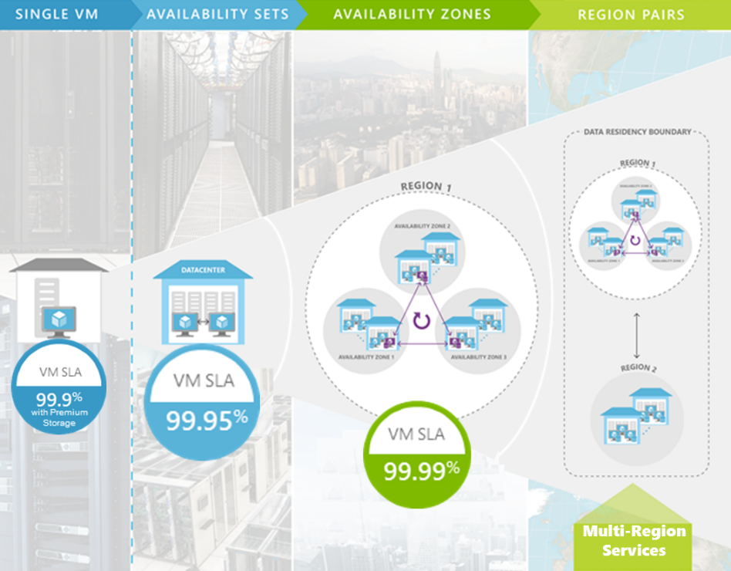
Disaster Recovery
High Availability
Availability Spectrum
Notes:
Physically separated locations within a region
Redundant power, network, and cooling
Reduce single points of failure in the platform
At GA, offer 99.99% High Availability

Slide 16

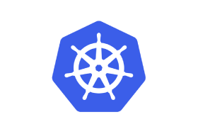

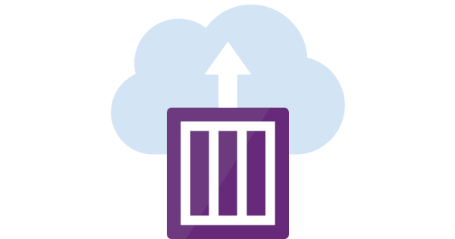
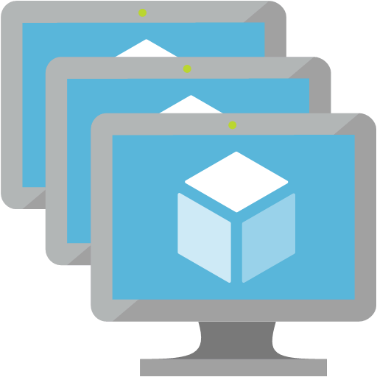
Functions
Serverless, Event-based platform
App Service
Web, Mobile, or API PAAS
Serverless, “Code-less”, Event-based platform
Logic Apps
Microservices .NET based platform
Managed containers Infrastructure
Service Fabric
Kubernetes (AKS)
Lift-and-shift
Scale identical VMs
& Elasticity
Individual containers with no overhead
Or burst your AKS
Container Instances
VMs
VM Scale Set

Slide 17
Storage
Azure provides a unified distributed storage system offering durability, encryption at rest, strongly consistent replication, and auto load-balancing
Notes:
Azure IaaS is designed for high-end workloads and will automatically scale up or down to 1000 instances
Azure has all the power & flexibility of a Virtual Machine:
Minimal learning curve for existing virtualization pros
Run most Windows or Linux-based workloads
Easiest target for migrating to the cloud
Flexible instance sizes—use the best fit for your workload
Advanced networking and storage capabilities
Per second billing with pay-as-you-go billing (or RI)
For existing virtualization pros, the learning curve is minimal as Azure runs on most Windows or Linux-based workloads
Virtual Machines offer advanced networking & storage capabilities
Virtual Machine Scale Sets:
All of the power and flexibility of a Virtual Machine
Designed for high-end workloads
Automatically scale up (or down) to 1000 instances
Availability Sets:
Disks: Persistent, secured disk storage for Azure Virtual Machines
Simple scaling on demand lets you create thousands of disks simultaneously in minutes
Industry-leading durability and availability simultaneously replicates your data to three different replicas.
Offers you more security with granular access control
Lets you easily migrate in minutes
Multiple storage options available

Slide 18
Secure, scalable and highly available storage options for every use case
Disk Storage
Object Storage
File storage
Premium
Standard
Azure Blobs
Azure Files
Azure NetApp Files
Reliable, persistent, high performing storage for Virtual Machines
Secure, centralized storage target for backup/disaster recovery
Lift and shift of legacy applications that require file shares to the cloud
Data Transport
Hybrid Storage
Azure Import/Export
Azure DataBox
Azure StorSimple
Azure File Sync
Avere*
Move or migrate data into Azure
Secure, intelligent data tiering between on-premises and cloud storage
Notes:
Azure IaaS is designed for high-end workloads and will automatically scale up or down to 1000 instances
Azure has all the power & flexibility of a Virtual Machine:
Minimal learning curve for existing virtualization pros
Run most Windows or Linux-based workloads
Easiest target for migrating to the cloud
Flexible instance sizes—use the best fit for your workload
Advanced networking and storage capabilities
Per second billing with pay-as-you-go billing (or RI)
For existing virtualization pros, the learning curve is minimal as Azure runs on most Windows or Linux-based workloads
Virtual Machines offer advanced networking & storage capabilities
Virtual Machine Scale Sets:
All of the power and flexibility of a Virtual Machine
Designed for high-end workloads
Automatically scale up (or down) to 1000 instances
Availability Sets:
Disks: Persistent, secured disk storage for Azure Virtual Machines
Simple scaling on demand lets you create thousands of disks simultaneously in minutes
Industry-leading durability and availability simultaneously replicates your data to three different replicas.
Offers you more security with granular access control
Lets you easily migrate in minutes
Multiple storage options available

Slide 19
Azure Disks
Performance Tiers
Simplified Management
Resource Group
Preview
Managed Disks Highly available and scalable
Premium SSD Disks Provisioned performance for Enterprise Prod
Standard SSD Disks Cost effective performance for entry-level workloads
Standard HDD Disks HDD based, cost effective for dev-test workloads
Industry leading ZERO % Annual Failure Rate
Best in class VMs with
High IOPS/BW
< 1ms latency for cached operations
Developer Support
REST API Support
Easy Migration / DR / Backup
Rich partner ecosystem
Enterprise grade durability with 3 replicas
80,000 IOPS & 2,000 MB/s
Disk throughput per VM
Blob Cache technology
Up to 160,000 IOPS
Notes:
Start with question:
- How many of you are using Azure Disks?
- How many of you are currently using Managed Disks?
How many of you are using Premium Disks?
What about Managed Premium Disks?
We have Disks offers based on the performance tiers:
Premium Disks, those are SSD based which provide high IOPS, throughput and consistent latency
Standard Disks using Magnetic drives which does not provide provisioned performance, however, this is a cost effective option for applications who do not require very high performance. This is ideal for test and dev workloads
We have recently introduced as a public Preview on June 4th - Azure Standard SSD Disks, a low-cost SSD offering, are optimized for test and entry-level production workloads requiring consistent latency. Standard SSD Disks can also be used for big data workloads that require high throughput. Standard SSDs deliver lower latency compared to Standard HDDs, while improving reliability and scalability for your applications, and are available with all Azure VM sizes.
Standard SSDs can be easily upgraded to Premium SSDs for more demanding and latency-sensitive enterprise workloads. Offered as a managed disk solution, Standard SSDs come with the same industry leading durability and availability that you expect from Azure Disks.
Lets look at Management options:
We recently launched Managed Disks which provide better manageability and support high availability deployment options. We have deep dive session on this topic so I am not going to spend too much time here.
We also have unmanaged disks, those are legacy disks. One of the unique capability is that we have REST support. You do not need to mount the disks to your VM to access the disks.

Slide 20
Networking

Slide 21






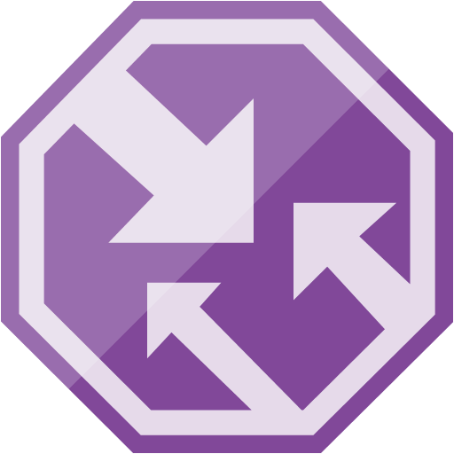
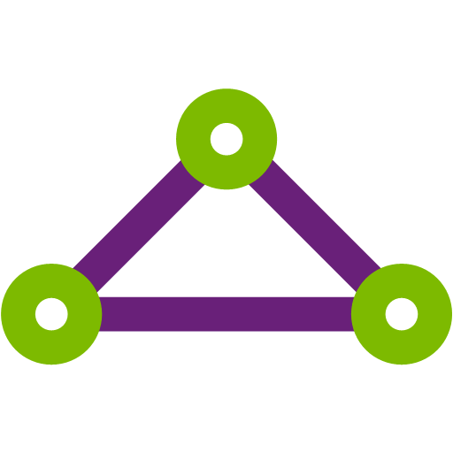

Native Networking infrastructure services available in Azure Platform
Virtual Network
Provision private networks, optionally connect to on premise datacenters. NSG, User Defined Routes, & IP addresses.
Load Balancer
Deliver high availability and network performance to your applications
Application Gateway/WAF
Build scalable and highly-available web front ends in Azure
DDoS Protection
Protect your Azure resources from DDoS attacks
VPN Gateway
Establish secure, cross-premise connectivity
Azure DNS
Host your DNS domain in Azure
Content Delivery Network
Ensure secure, reliable content delivery with broad global reach
Traffic Manager
Route incoming traffic for high performance and availability
ExpressRoute
Dedicated private network fiber connections to Azure
Network Watcher
Network performance monitoring and diagnostics solution
Notes:
These are all the component pieces of Azure’s networking infrastructure

Slide 22
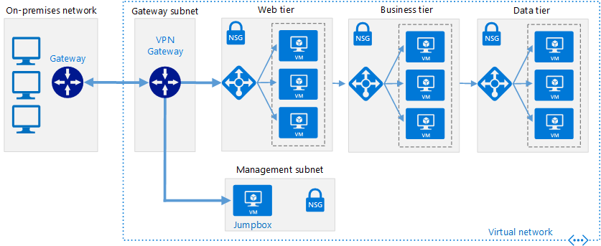
Example: VPN connection from on prem to Azure using Azure Built In VPN Gateway

Slide 23
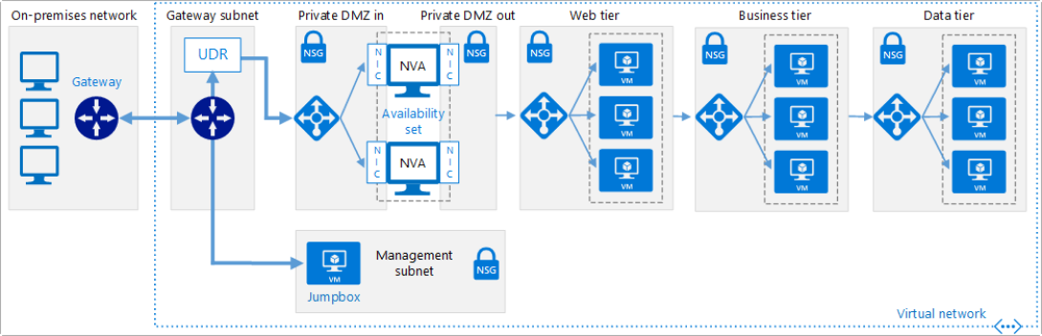
Example: VPN using Virtual Network Appliance
Note: In order to do a deployment like this, you will most likely need to create a custom deployment programmatically as most third party vendors do not offer this in the Azure marketplace.

Slide 24
Security and Management
Azure Active Directory
Cloud based directory and identity management
Azure Resource Manager
Organize, deploy and control resources in Azure
Azure Security Center
Prevent, detect, and respond to threats with increased visibility
Azure Advisor
Optimize across four different areas: high availability, performance, security, and cost
Azure Log Analytics
Collect, search, and visualize machine data from on-premises and cloud
Azure Key Vault
Protect secrets such as passwords and keys securely
Azure Backup
Protect your virtual machines, data, or enterprise workloads by securely backing it up to Azure
Azure Site Recovery
Orchestrated failovers/back to Azure, Azure to Azure or data center to data center–great for migration!
Notes:
Azure offers all these tools to manage and secure your data including the Azure Security Center to prevent, detect and respond to threats, Azure Backup, and Azure Site Recovery

Slide 25
Jump to Azure API intro & PowerShell Demos

Slide 26

Questions?

